Slide 1
One Page Feed Formulation for Poultry &Pigs etc.
This workbook had its’ origins in a journal article:
Gene M. Pesti, Andrew F. Seila 1999 The Use of an Electronic Spreadsheet to Solve Linear and Non-Linear “Stochastic” Feed Formulation Problems. Journal of Applied Poultry Research 8, 110-121, ISSN 1056-6171
This version was further developed by Gene Pesti at the Poultry Hub Australia

Slide 2
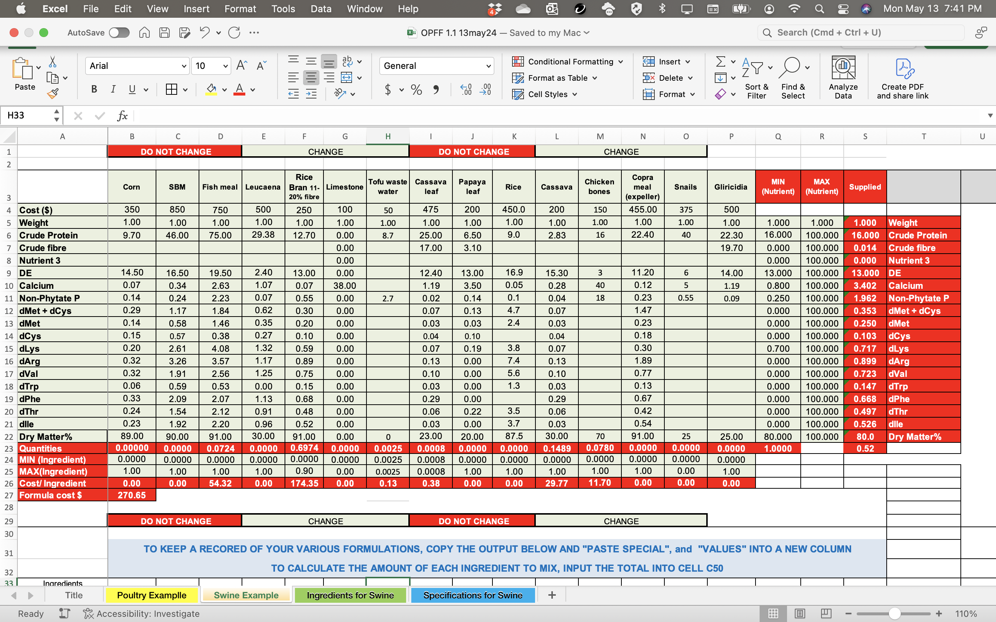
Excel can be set up to solve linear (least cost) feed formulation problems
Solving the problems requires the free Solver Add-In

Slide 3
For a swine example, choose the “Swine Example” tab
For a poultry example, choose the “Poultry Example” tab

Slide 4
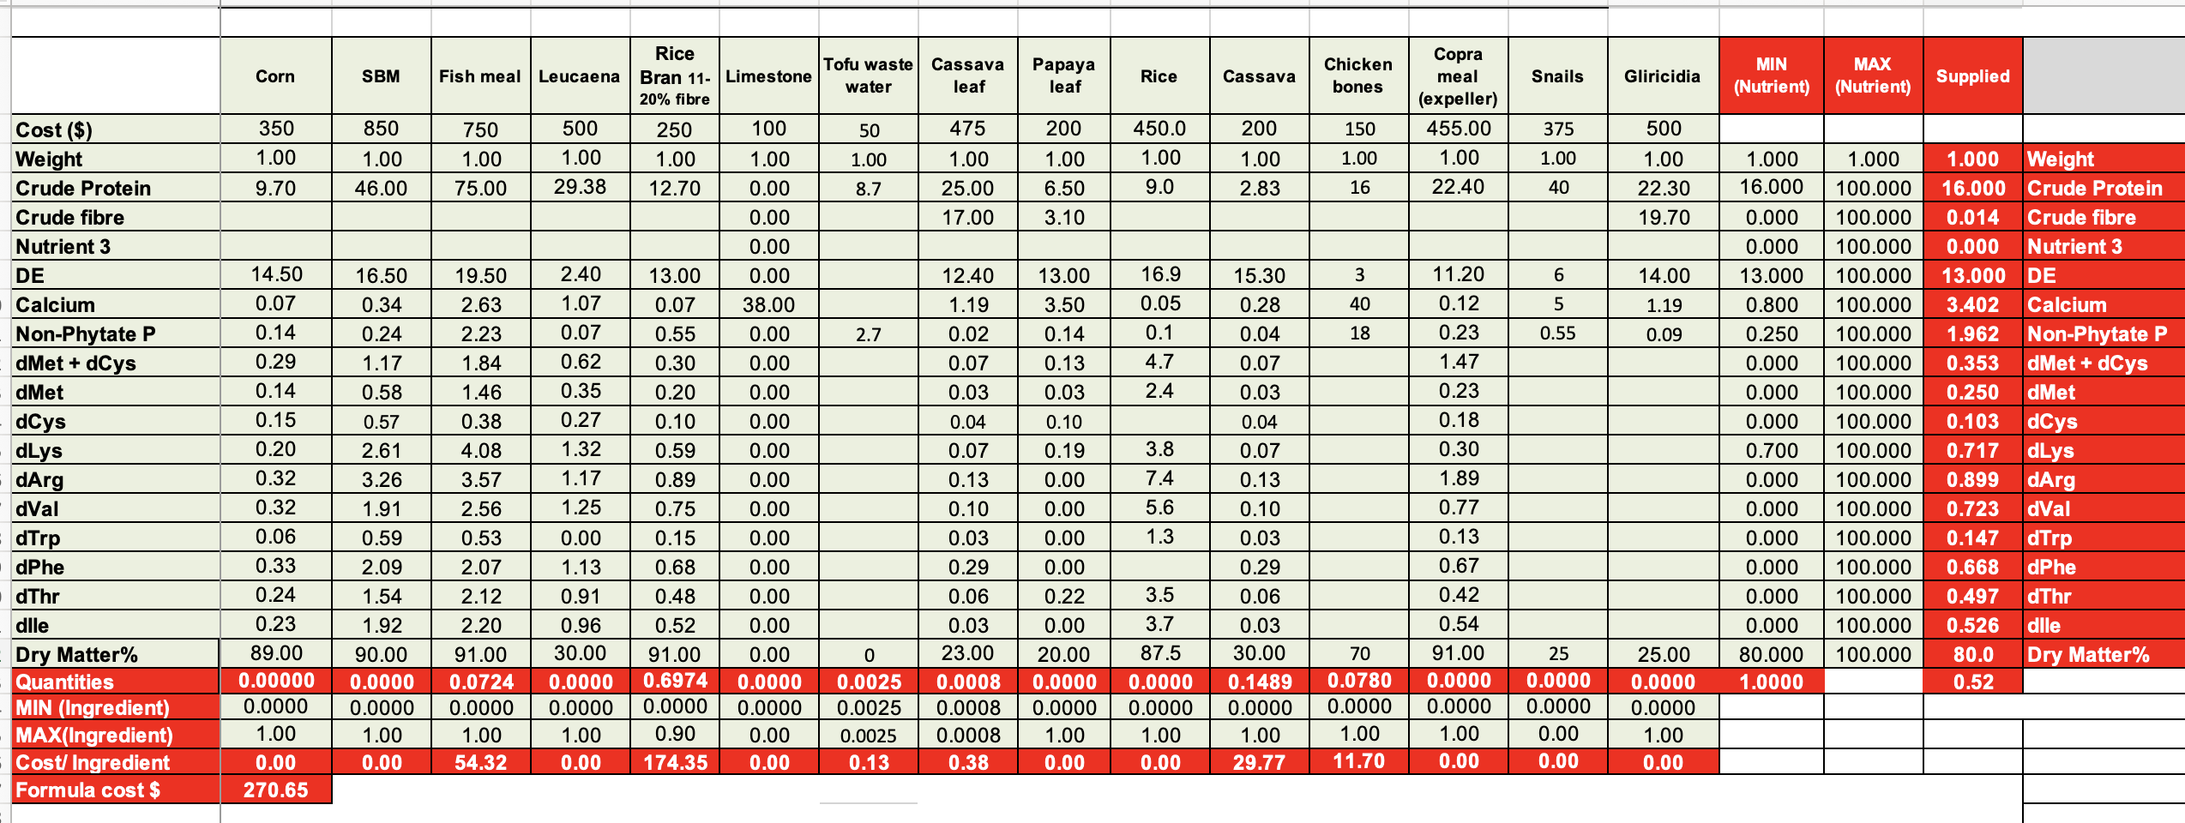
The objective of a feed formulation problem is to minimize the cost of the feed based on:
2
  The objective function, the total cost per unit of feed
  Ingredient costs
1

Slide 5
The least cost diet is subject to restrictions in
3) Ingredient composition matrix,
4) the Ingredient limits (Minimum and Maximums)
And 5)the Nutrient limits (Requirements and Maximums)
3
5
4

Slide 6
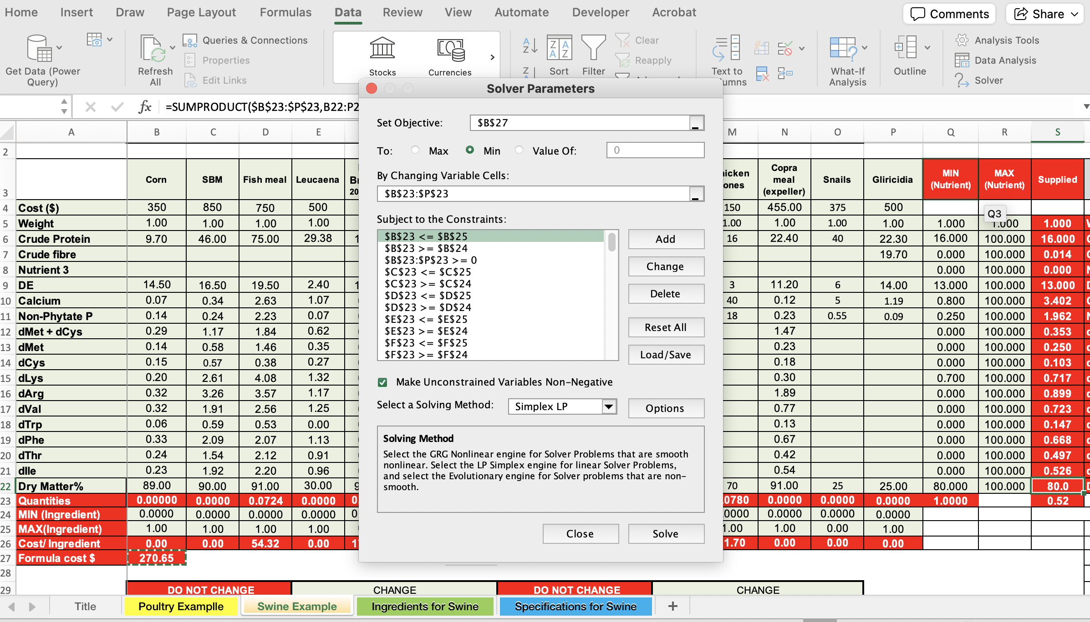
1
2
Once the matrix is completed, choose
1) Data; 2) Solver; and 3) Solve
3

Slide 7
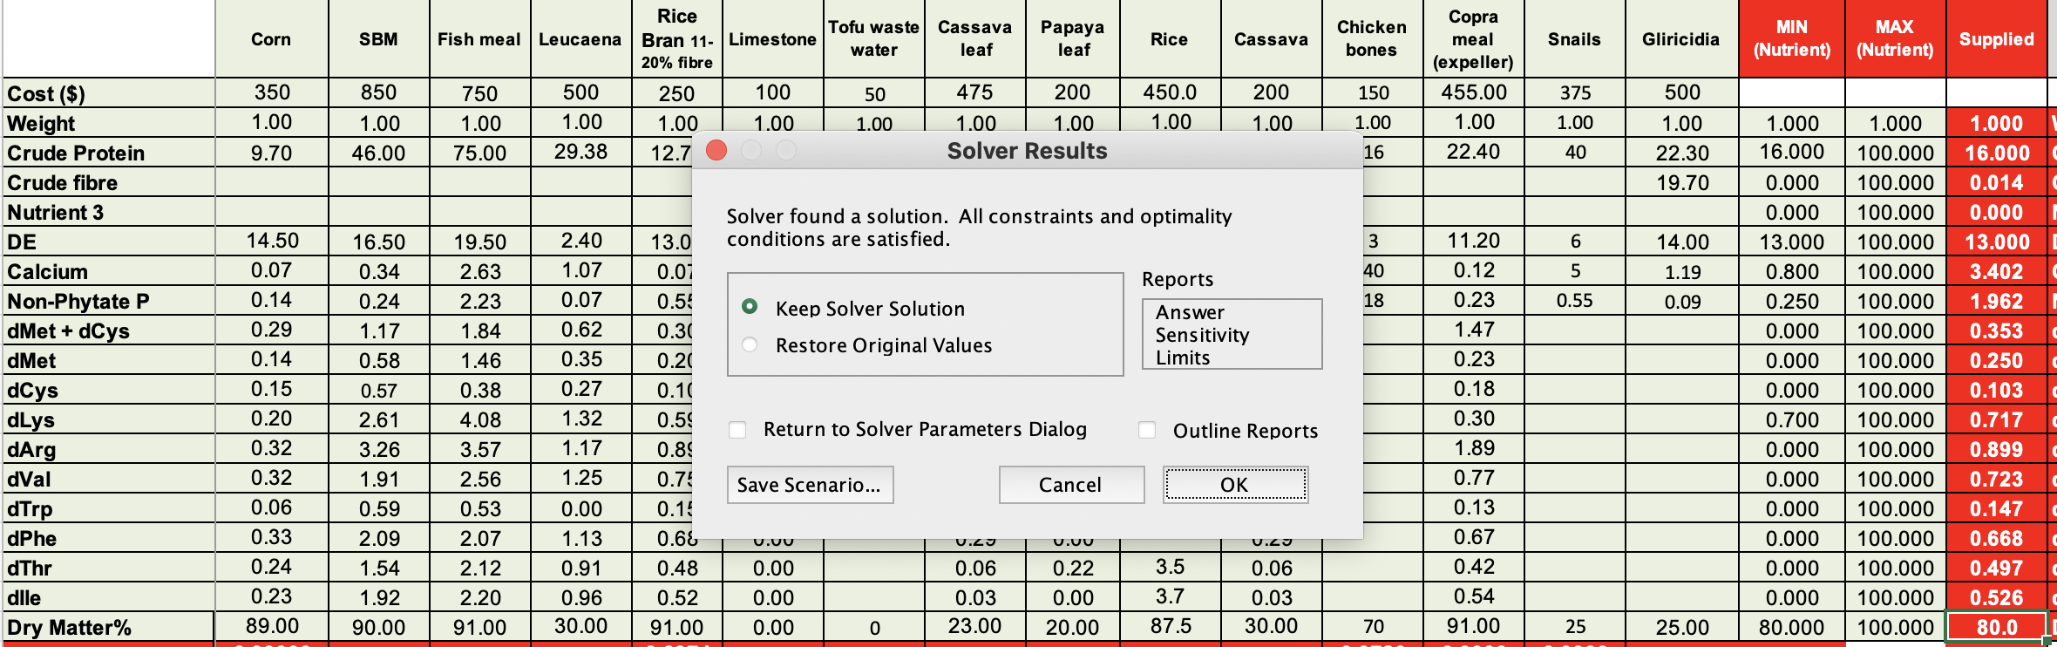
When the “Solver Results” dialog box appears be sure it says ”Solver found a solution” and click on “OK”

Slide 8
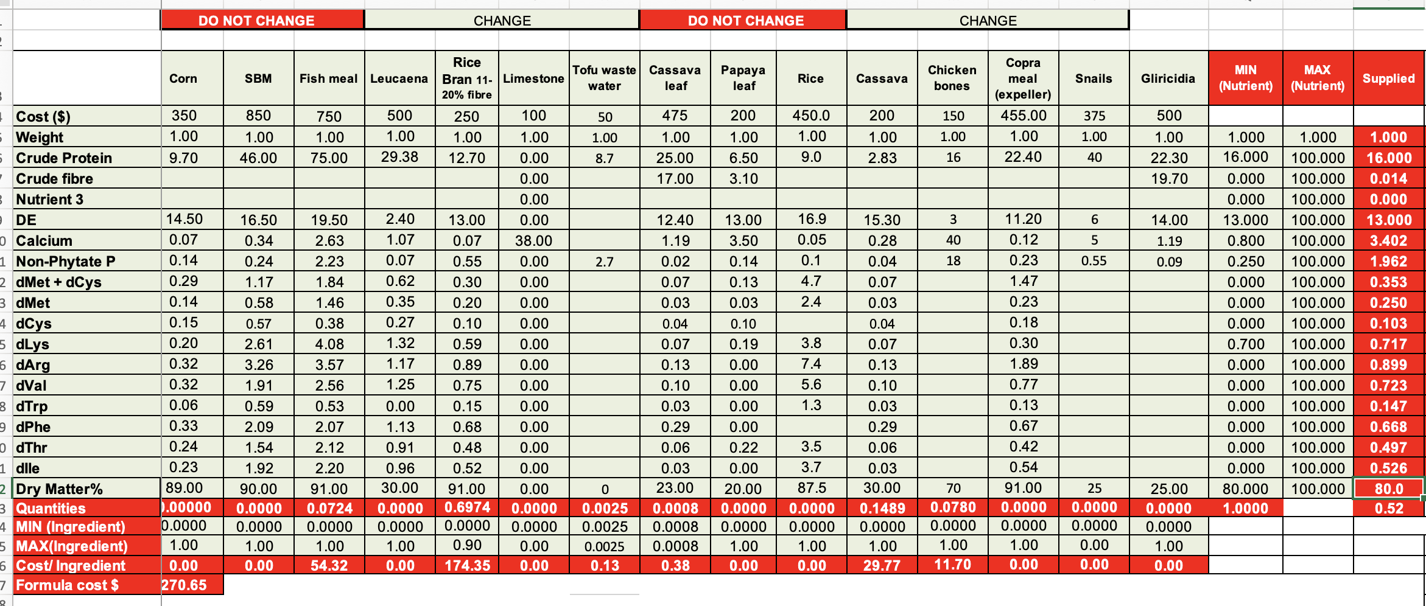
The least-cost solution appears in Row 23 under the title “Quantities”

Slide 9
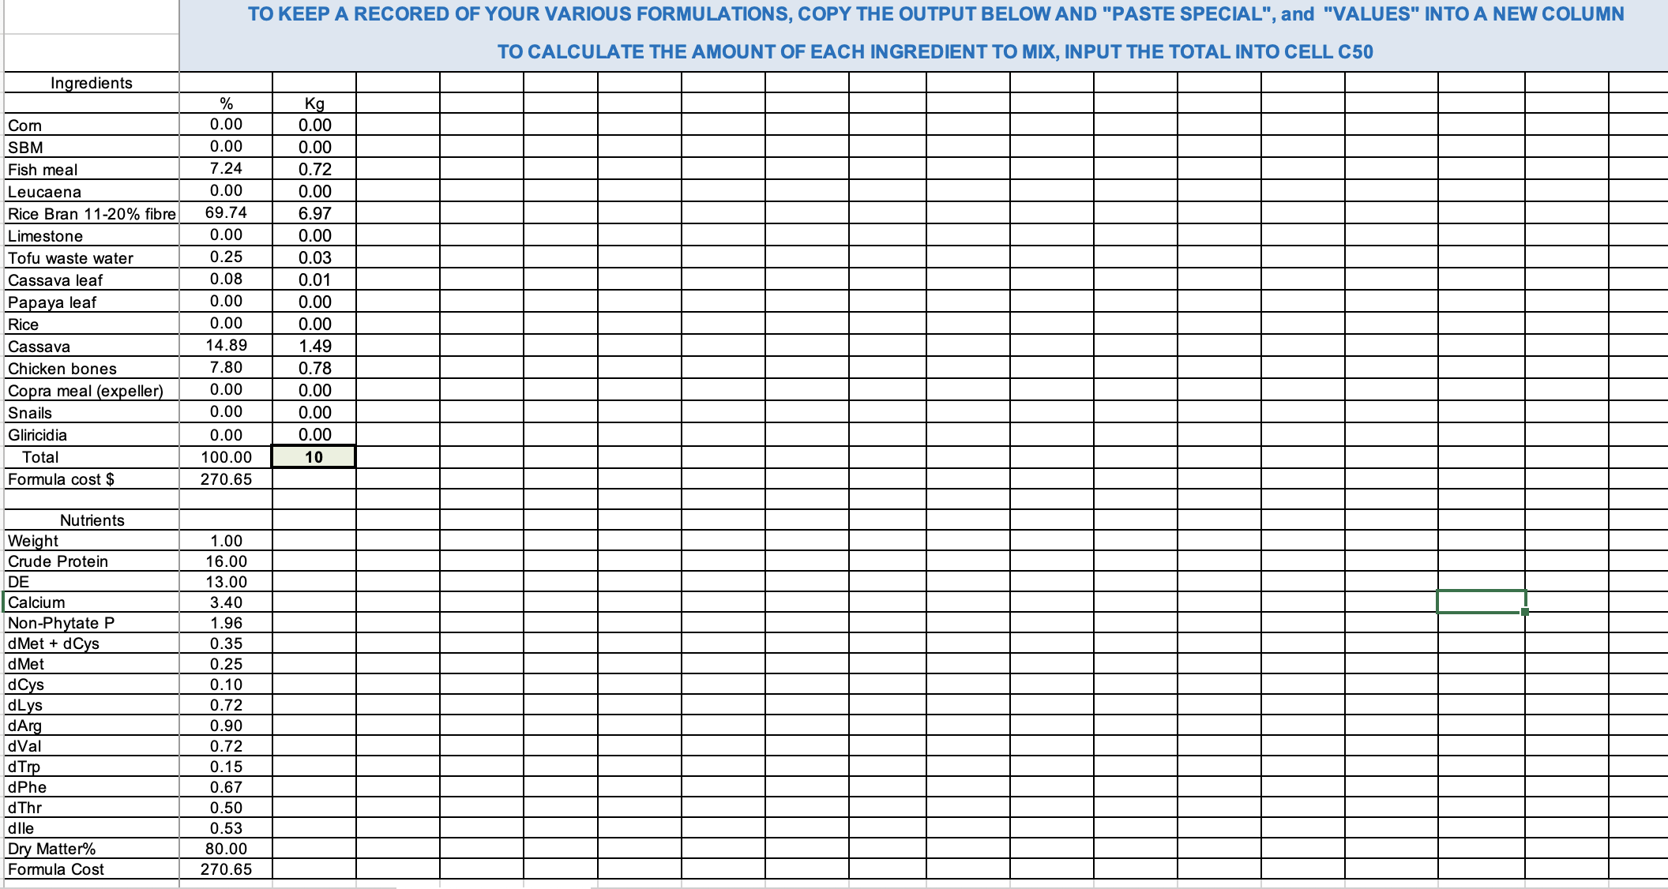
And also in cells B34 to B70 formulas reference rows and cells above
Follow the instructions in Row 31 to save a copy of each diet you create

Slide 10
Enter the total number of Kg of feed you will need in cell C50
The amount of each ingredient will be displayed in cells C35 to C49

Slide 11
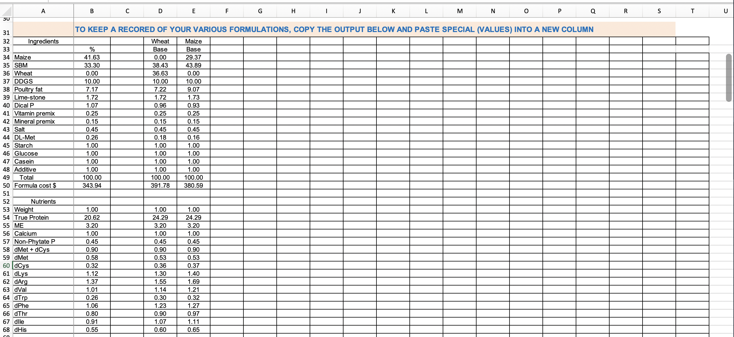
By copying the solutions to various formulations, a permanent solution of each feed mix is saved
If the formulations involve changing prices, they can also be included to keep a record of why solutions changed

Slide 12
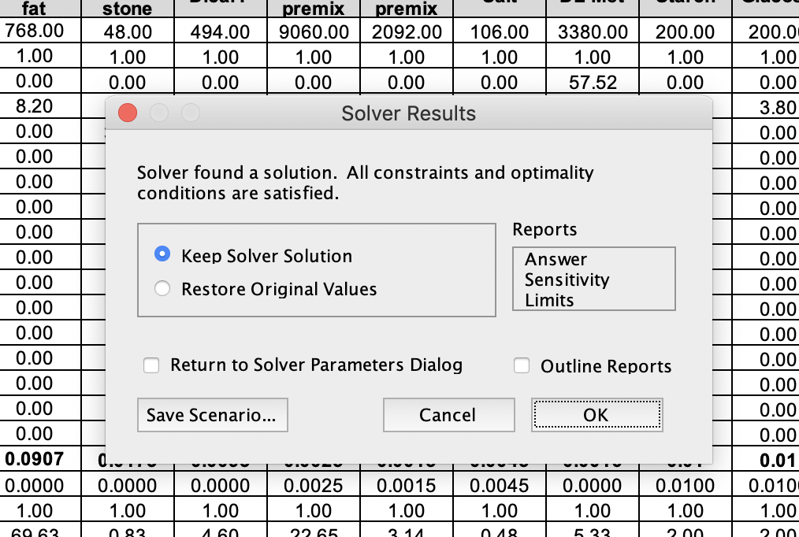
Shadow prices are the maximum ingredient prices that would be included in the final formulations
To find them click on “Sensitivity Report” when the Solver Results window appears

Slide 13
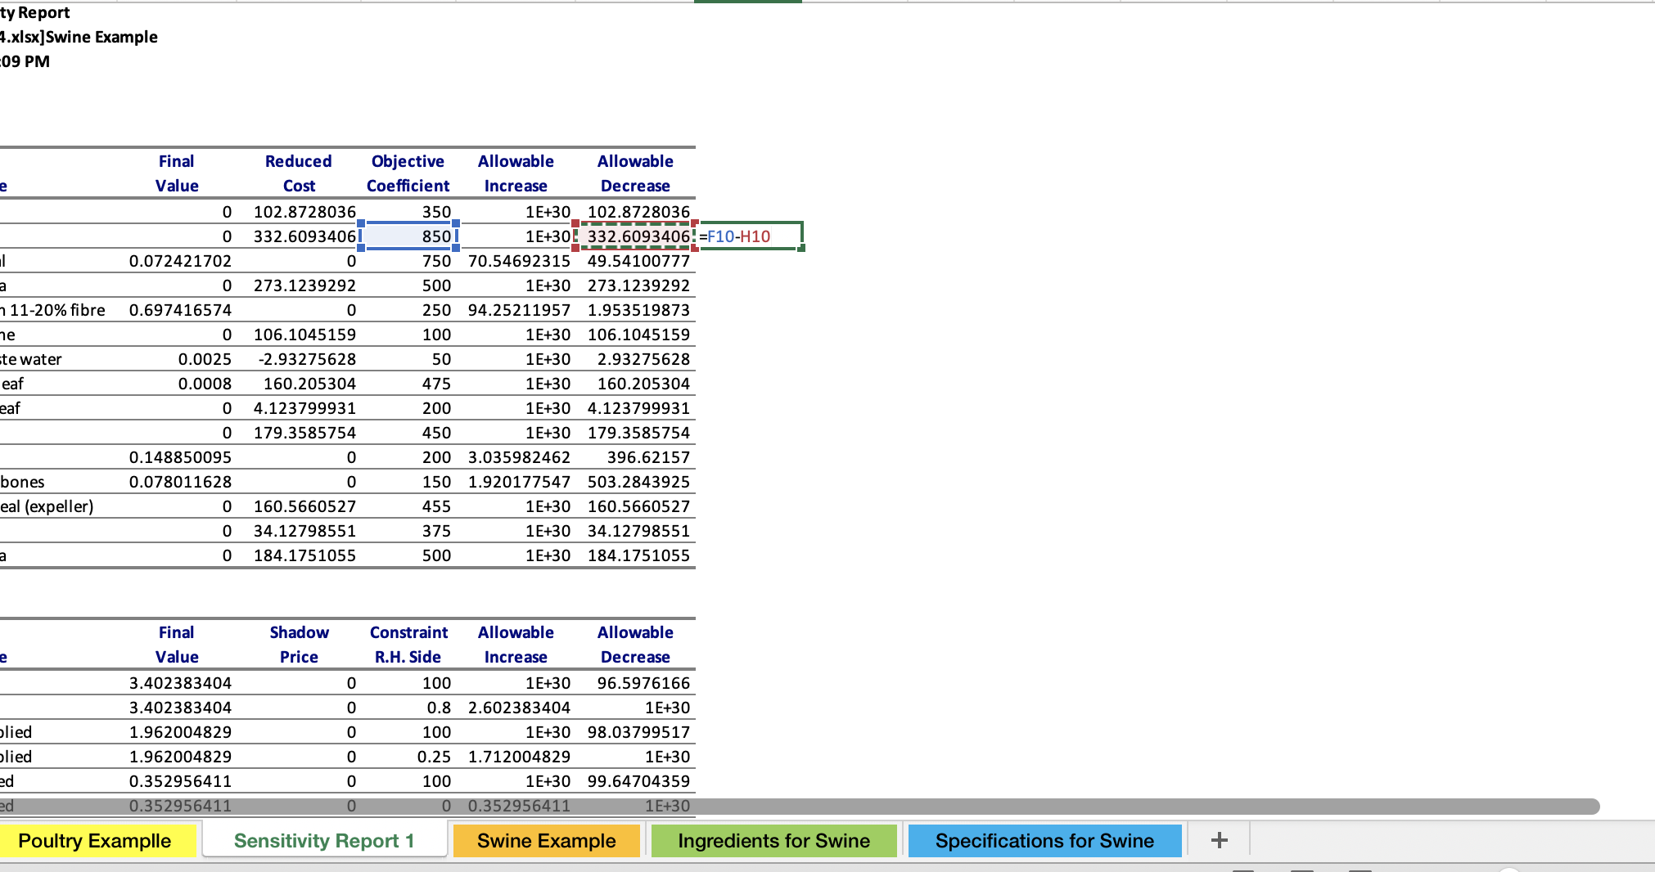
When the Sensitivity Report appears, it contains the information needed to calculate “Shadow Prices”
In this case SBM was not included in the formulation
  “Final value” = 0
Because it’s cost was too high
  “Objective Coefficient” = 850
The cost would have to decrease to be included in the formulation
  “Allowable Decrease” = 332.60…

Slide 14
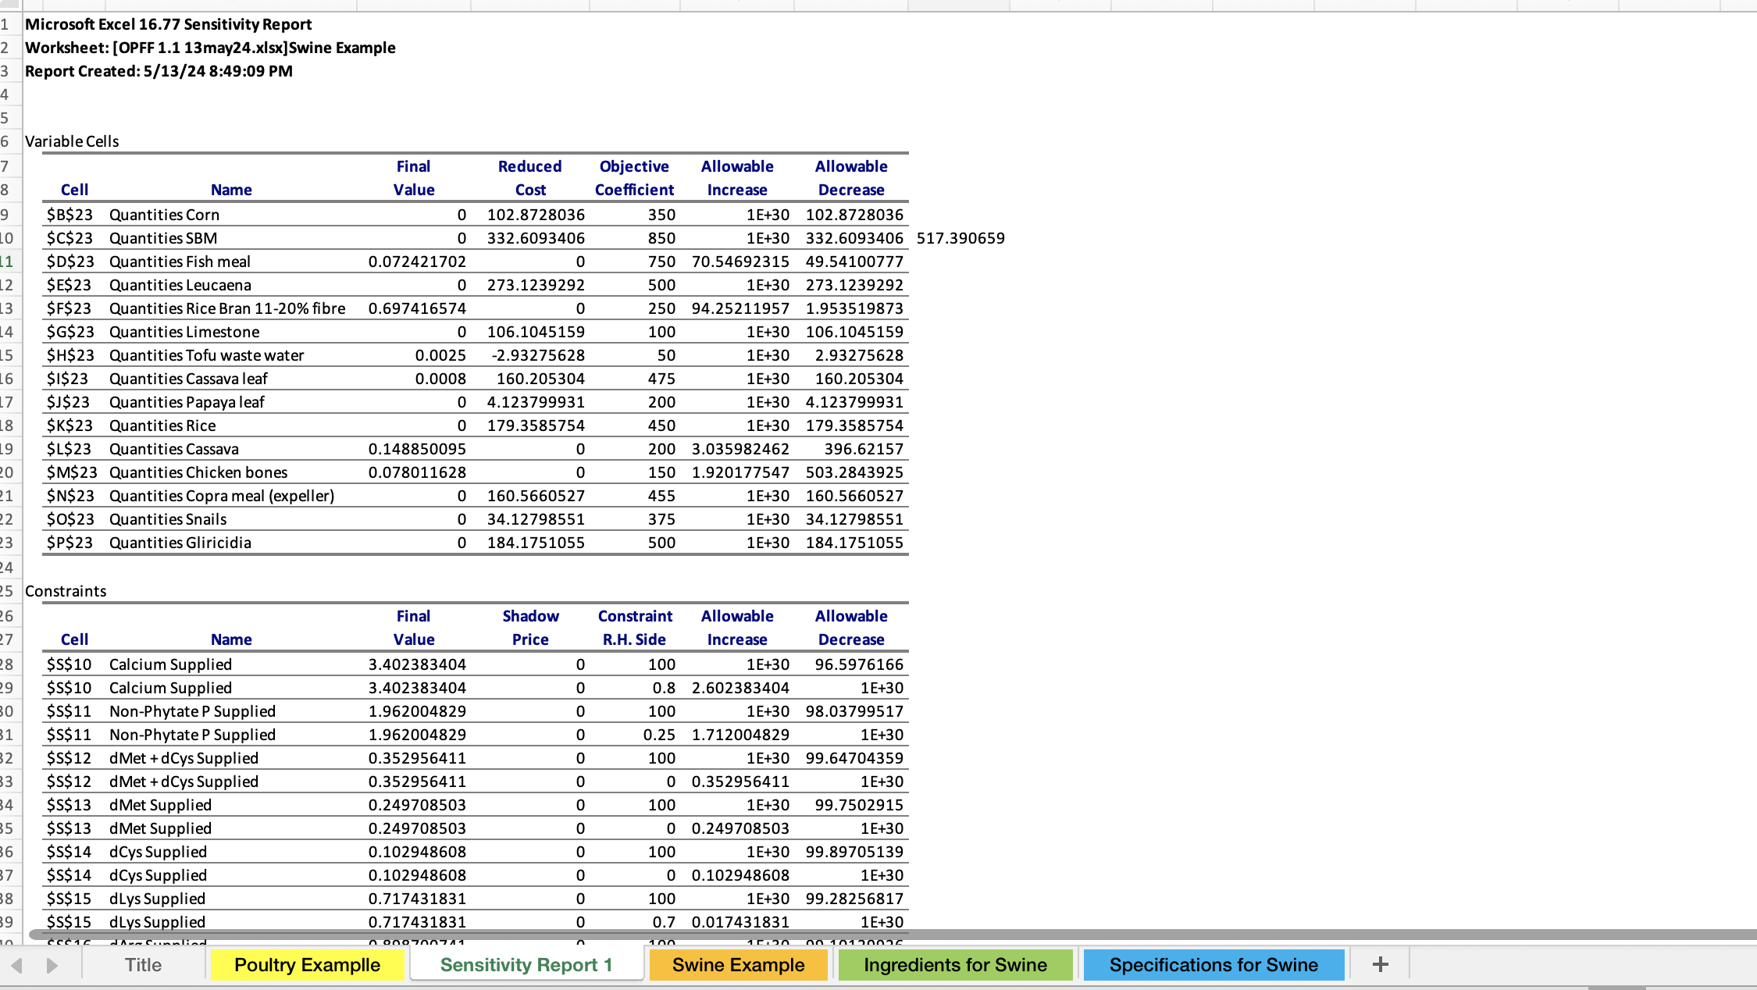
At less than $517.39, SBM should be included in the final formulation
But only with these prices for Rice Bran, Fish Meal, Casava, etc.
If the price of any other ingredient with common nutrients with SBM were to change, the shadow price for SBM would also change

Slide 15
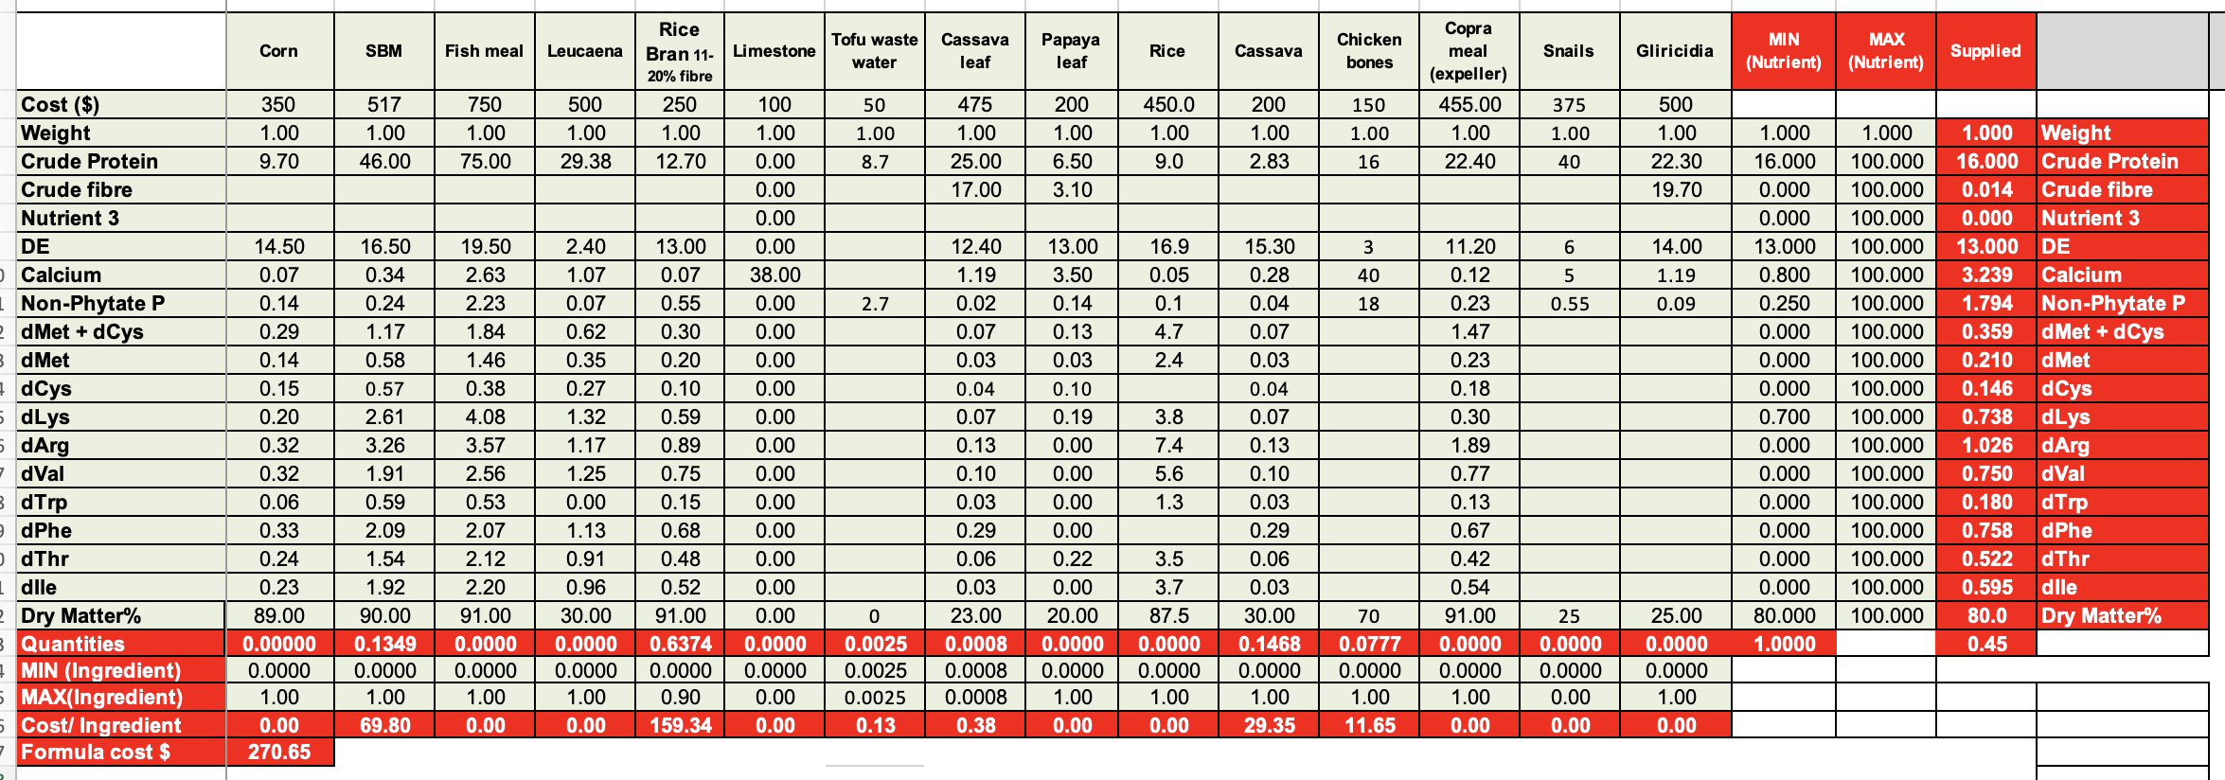
With SBM included at $517.38, the formulation contains 13.49% SBM and less Rice Bran
The Formula cost is unchanged so it doesn’t matter if SBM is used at $517.38 or Rice Bran at $250

