Slide 1


A Short Tutorial On Using

Slide 2
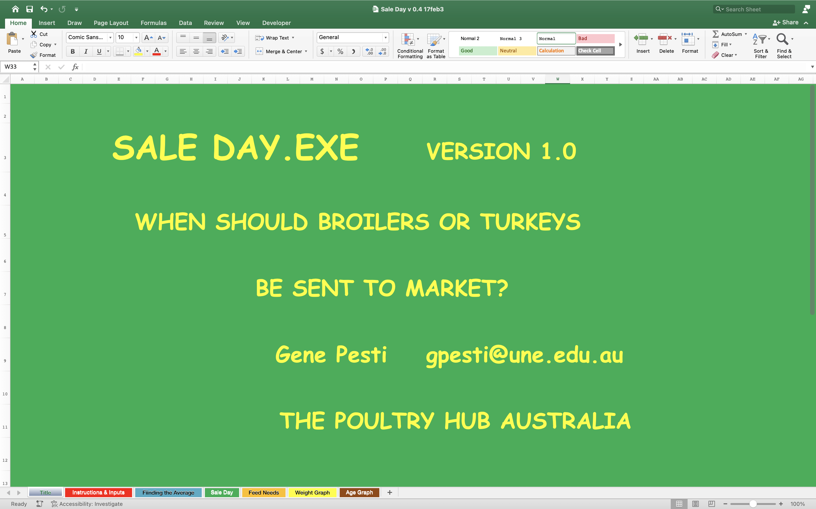
There are 7 Spreadsheets in SaleDay.xlsx
You should only change cells that have yellow backgrounds. Changing others will change the workbook’s functionality.
It may be helpful to always save a backup of the original workbook in case a cell gets accidentally changed.
Title
Instructions and Inputs
Finding the Average
Sale Day
Feed Needs
Weight Graph
Age Graph

Slide 3
Three things to know when planning a business venture:
The cost of the inputs
The technical relationship between inputs and outputs
What you will sell your product for
  Most important
  What profit will you accept for your efforts?

Slide 4
1. The cost of the inputs:
Inputs include everything you have to pay for housing, birds, feed, labor, etc.
SaleDay.xlsx only calculates returns over feed costs.
  It assumes all the other costs are already paid, or “sunk”.
  Returns are calculated for live birds per kg body weight.
    If you are selling processed birds, you may want to add a column with carcass yields.

Slide 5
2. The technical relationship between inputs and outputs
This is the production function of broiler chickens
The growth of chickens has increased dramatically since the 1950’s
The shape of the production function has not changed since the 1950’s
SaleDay.xlsx fits the standard curve through your expected point with the standard shape

Slide 6
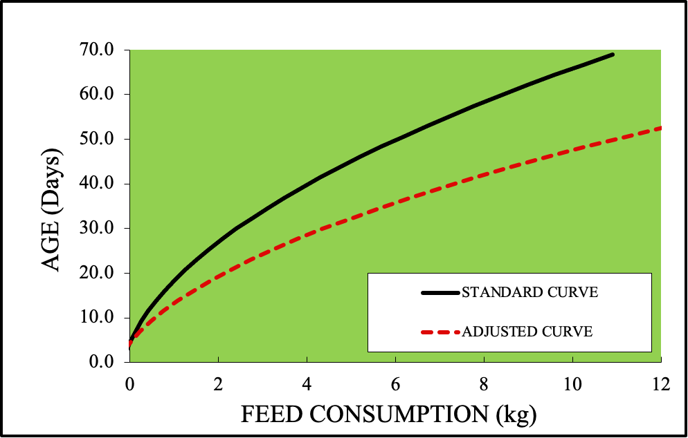
2. The technical relationship between inputs and outputs
The general shape of the relationship between feed consumption and age has also been constant for a long time
SaleDay.xlsx fits the standard curve through your expected point

Slide 7
2. The technical relationship between inputs and outputs
You can start entering data on the ”Instructions & Inputs” tab

Slide 8
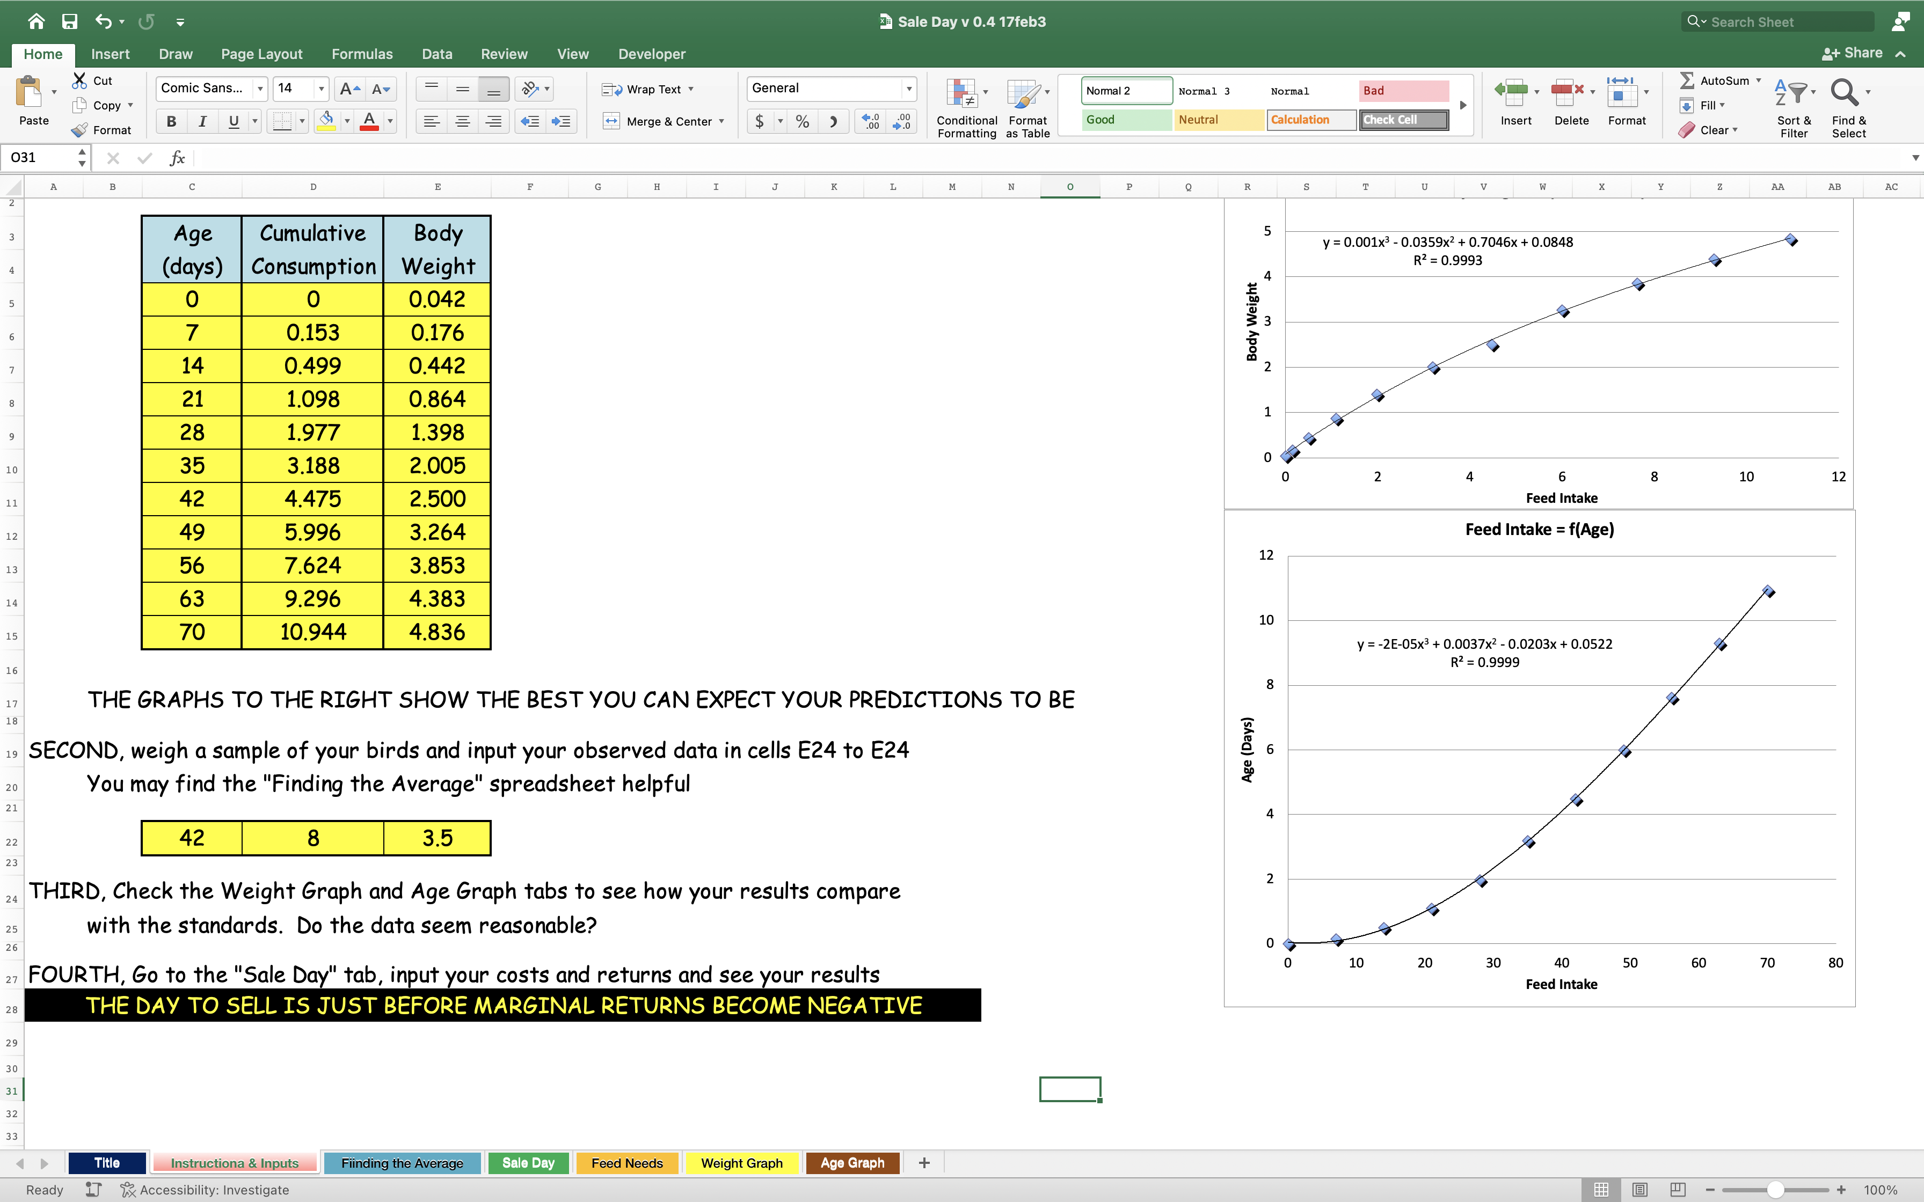
2. The technical relationship between inputs and outputs
You can leave the default data on the “Instructions and Inputs” page or enter one specific for your breed of chickens
Be sure to fill all 11 ages in the yellow area

Slide 9
2. The technical relationship between inputs and outputs
The data entered in they yellow cells is graphed on the right of the window
This is for checking that the data is entered correctly

Slide 10
2. The technical relationship between inputs and outputs
Then enter the expected data for your birds
You may want to use:
  breeder management guide expectations
  Your own last flock’s performance
  Your own last flock’s performance during the same season
  Your best estimate from any and all factors

Slide 11
2. The technical relationship between inputs and outputs
The projected production function of your birds will be displayed on the Weight Graph and Feed Graph tabs

Slide 12
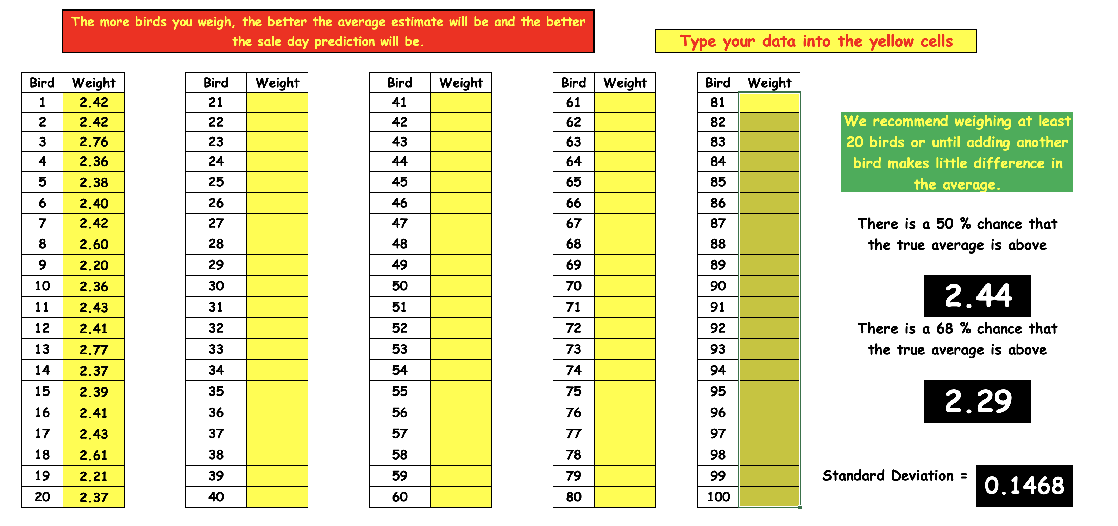
We recommend weighing at least 20 birds or until adding another bird makes little difference in the average.
The “Finding the Average” spreadsheet may be helpful for finding when you have weighted a big enough sample of your birds

Slide 13
3. What you will sell your product for
The ”Sale Day” spreadsheet is where the answers are found

Slide 14
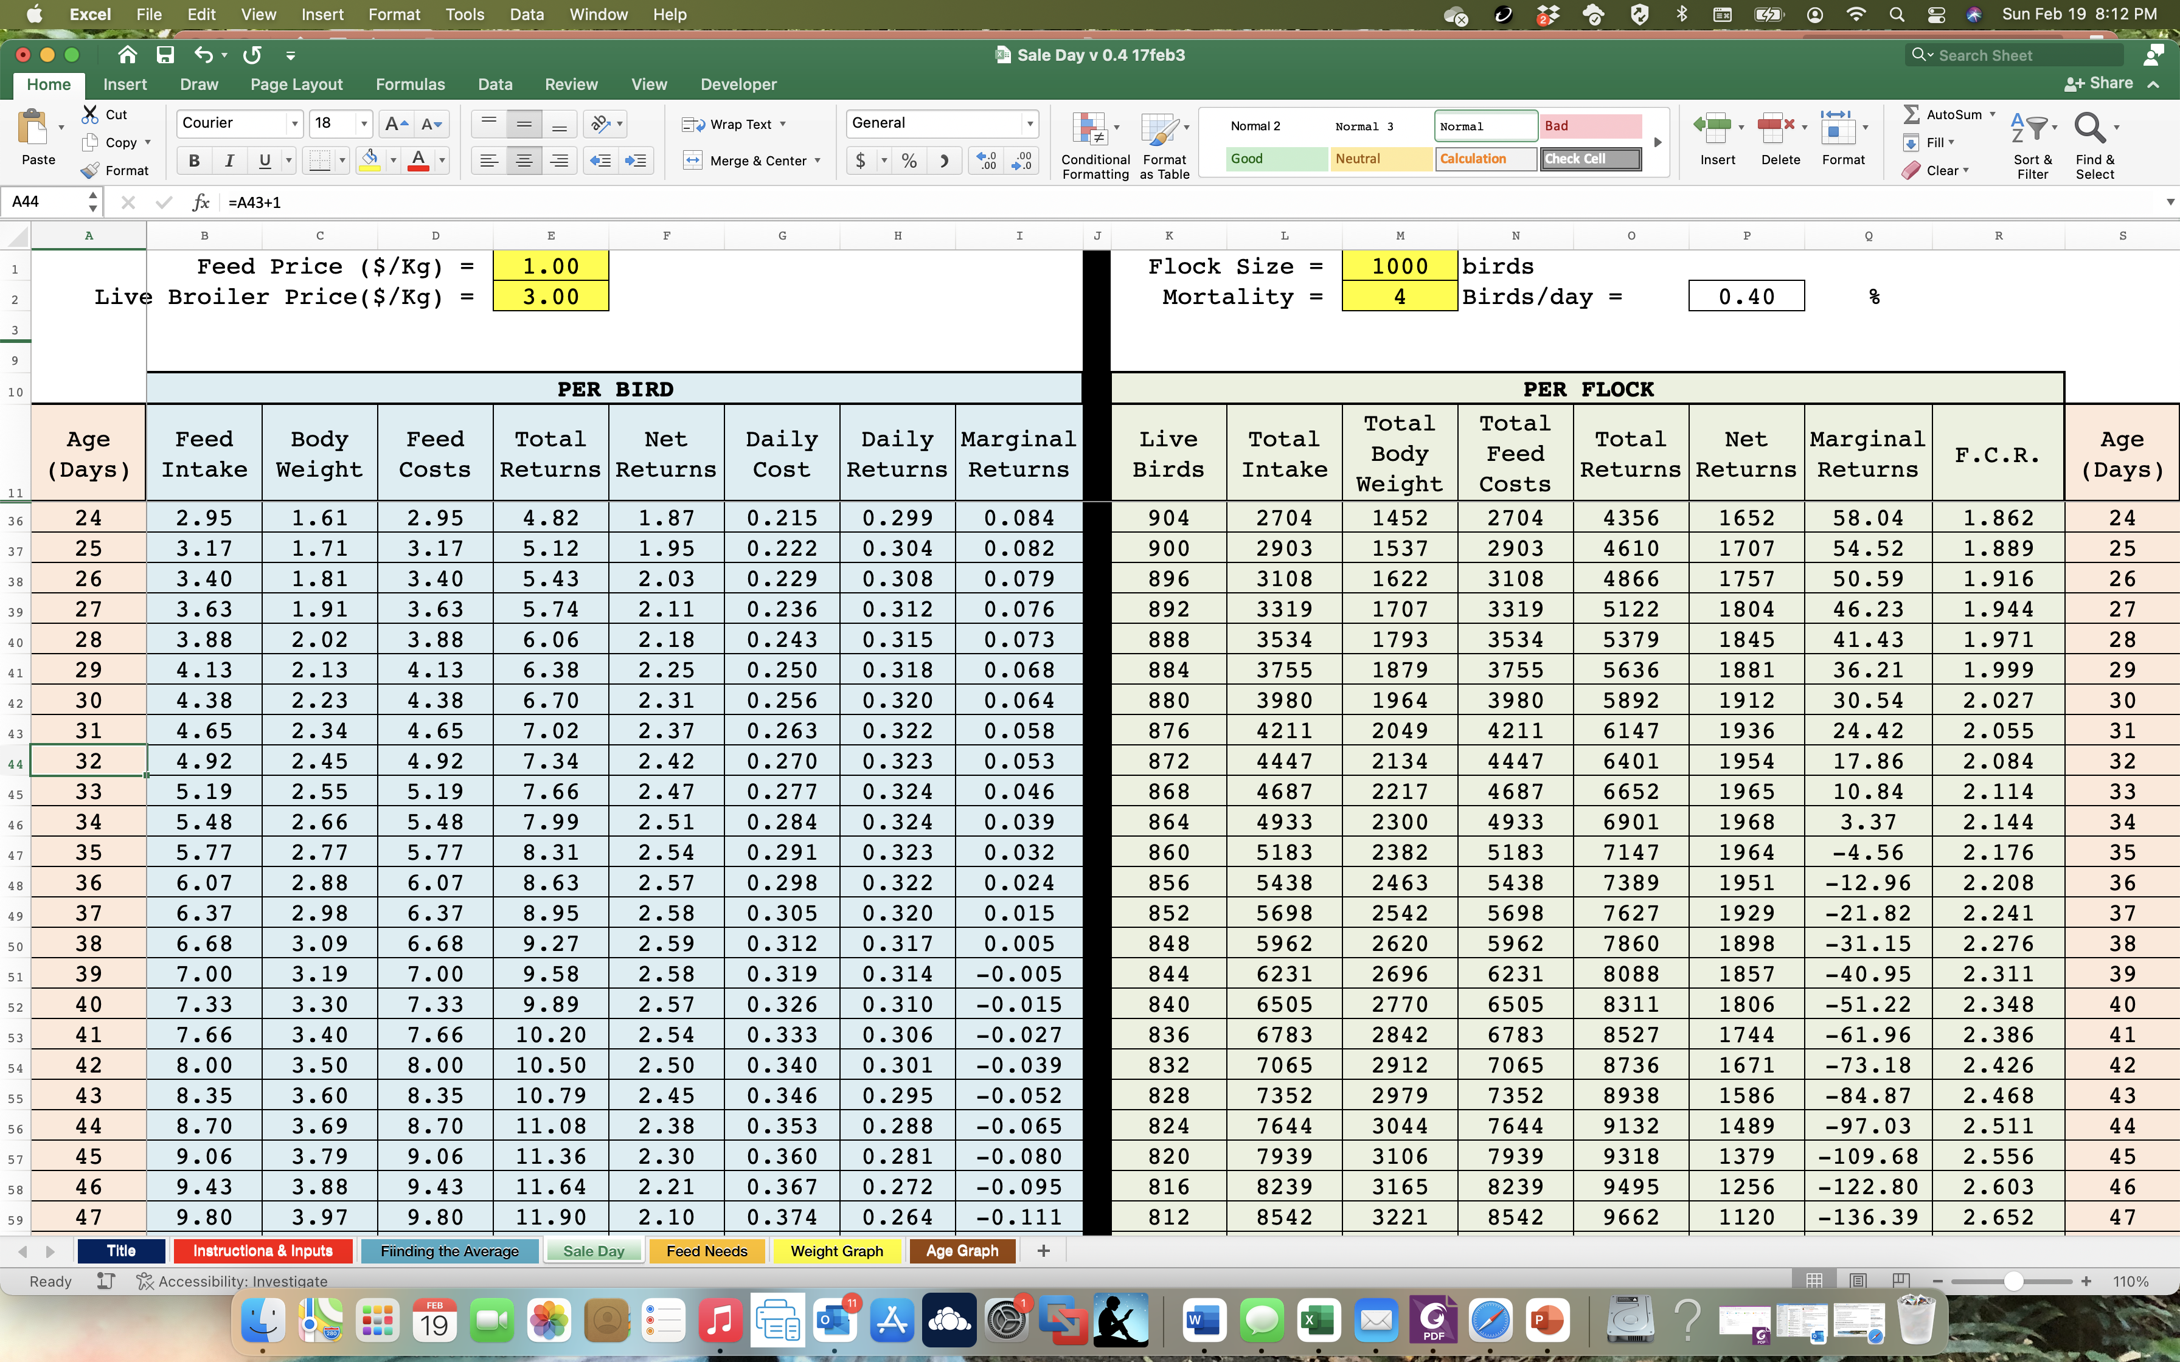
3. What you will sell your product for
On the Sale Day tab enter the Feed Price, Live Broiler Price, your flock size and what you expect the average daily mortality to be.
The daily economic data will be instantly calculated

Slide 15
What day should you sell your flock?
1. From the production function and the daily costs for feed and daily returns from broiler weight, the total costs and returns to feed cost are calculated.
2. Marginal returns are the returns from feeding during the last day.
3. The birds will continue to make profits until the marginal returns become zero

Slide 16
What day should you sell your flock?
1. The rate of mortality is very important in determining how much feed will be needed and what age to sell the flock at.
2. Because dead birds are expected to eat up until they die, but return no revenue, higher mortality rates greatly favor selling birds at earlier ages.

Slide 17
What day should you sell your flock?
The ”Feed Needs” spreadsheet can help with planning how much feed to order.
While feed needs are calculated on a daily basis, feeds need not be switched on a specified day.
The the birds have eaten all of one feed they should be offered the next.
Thus the critical feed is the last one. Ordering should be done as late as possible to have the best idea of how each flock is eating.

Slide 18
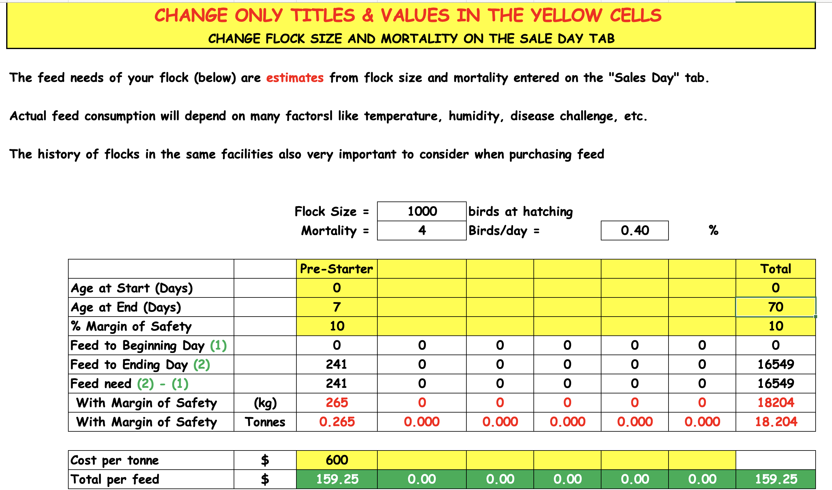
Enter up to 7 different feeds, feeding days and feed cost / tonne

Slide 19
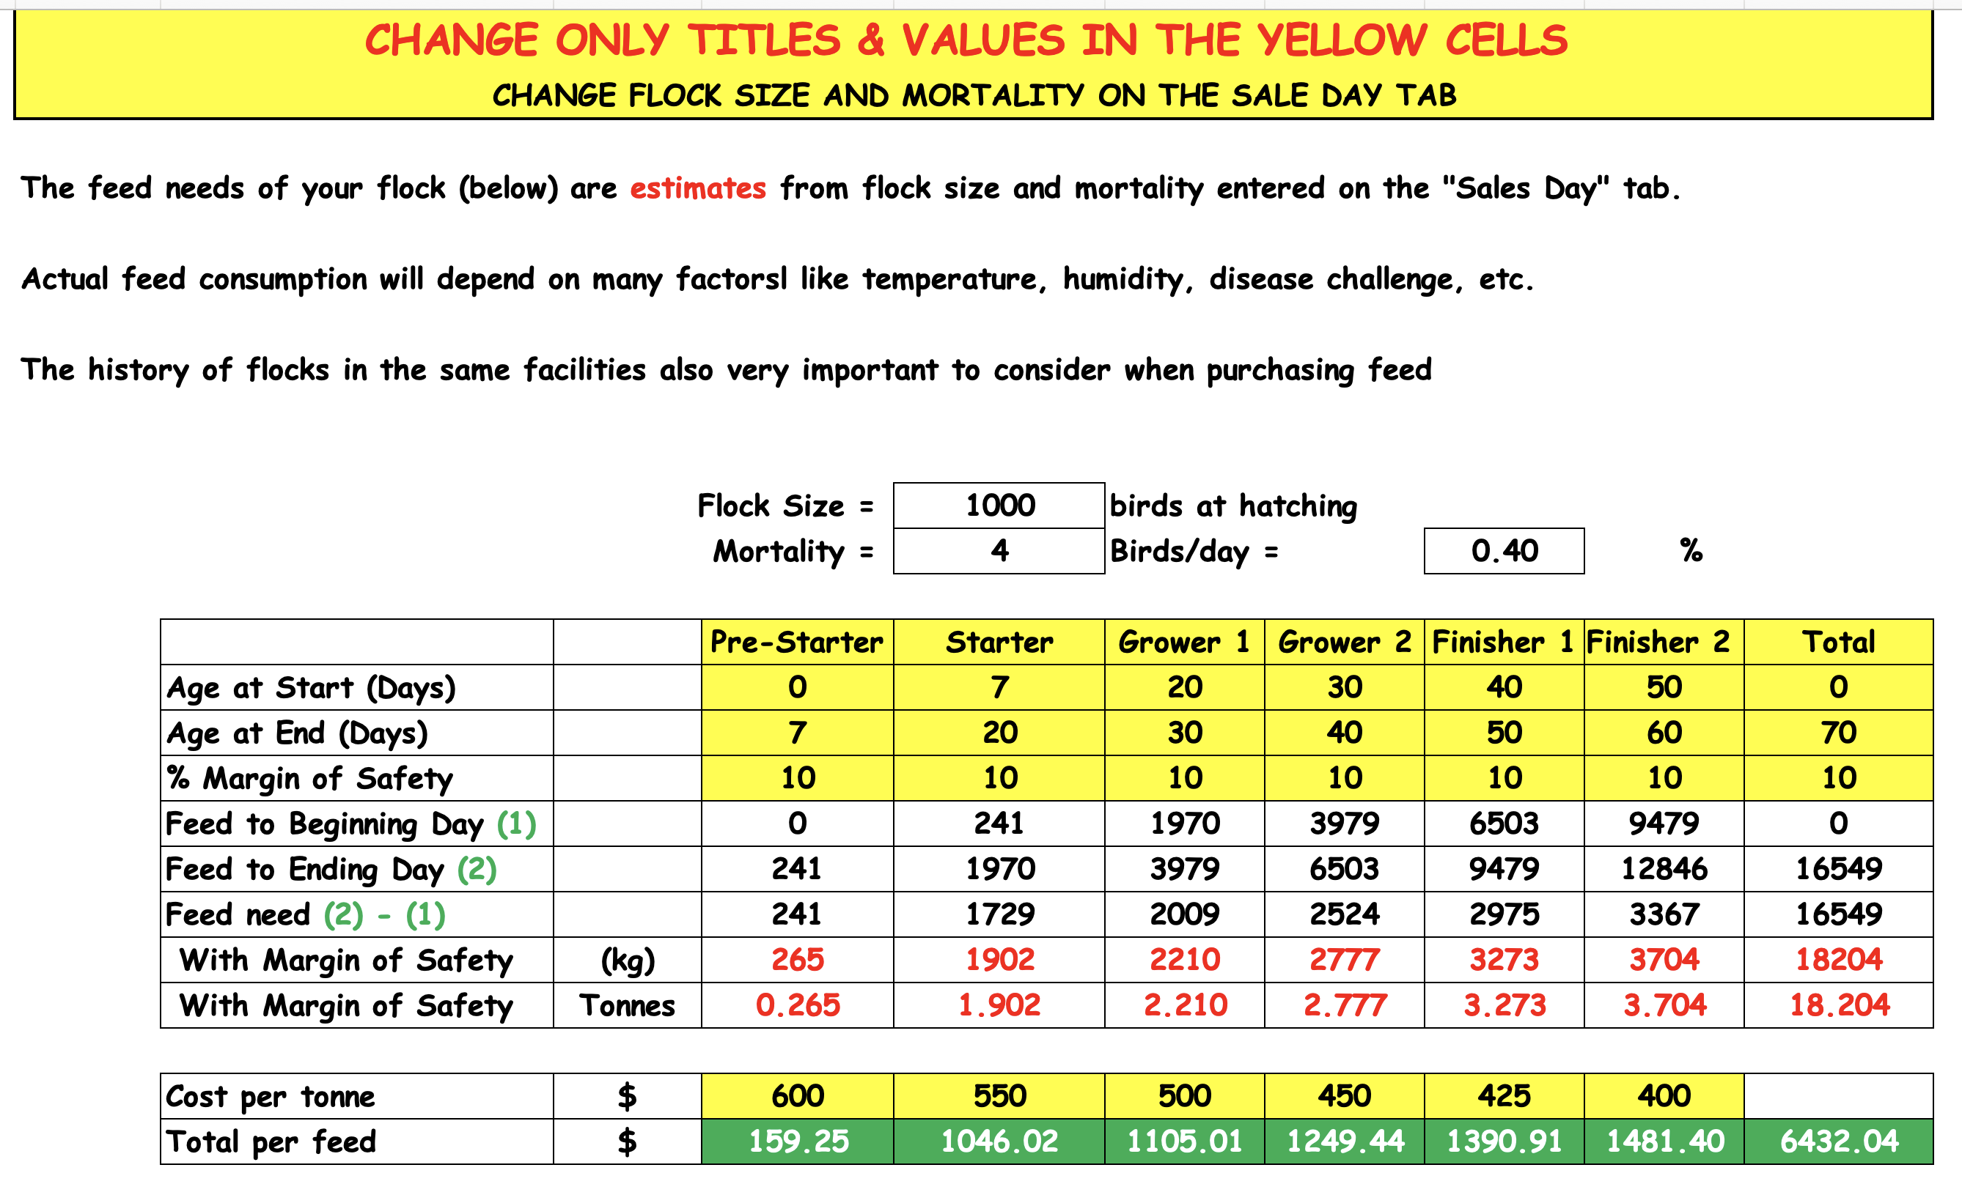
The Margin of Safety may be very small until the last feed when it is important not to run out.
It is important not to leave extra finisher feed in the feeders for the next flock.

